Slide 1
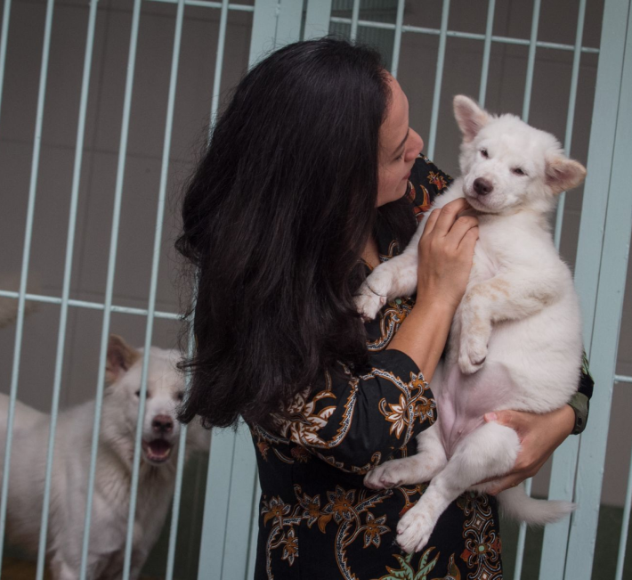


ASUKI Your Forever Soulmate
A puppy adoption platform
By Group 1

Slide 2
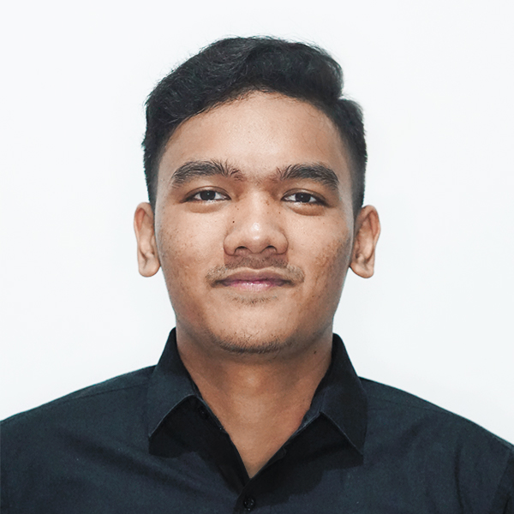
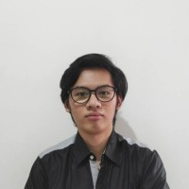
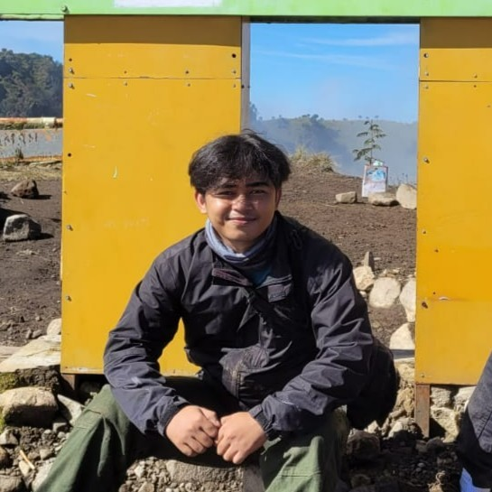
Meet our Asuki’s team
Sedana Yoga
UI/UX Designer – Frontend – DevOps
Timotius W.
Frontend– Backend
Wildan Fadillah
Frontend– Backend

Slide 3
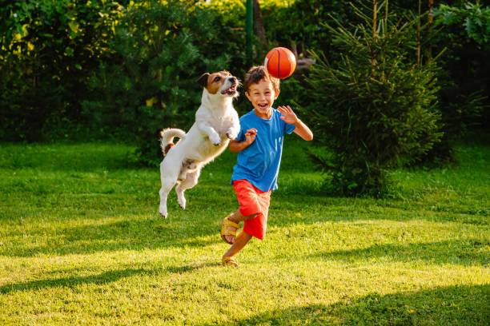
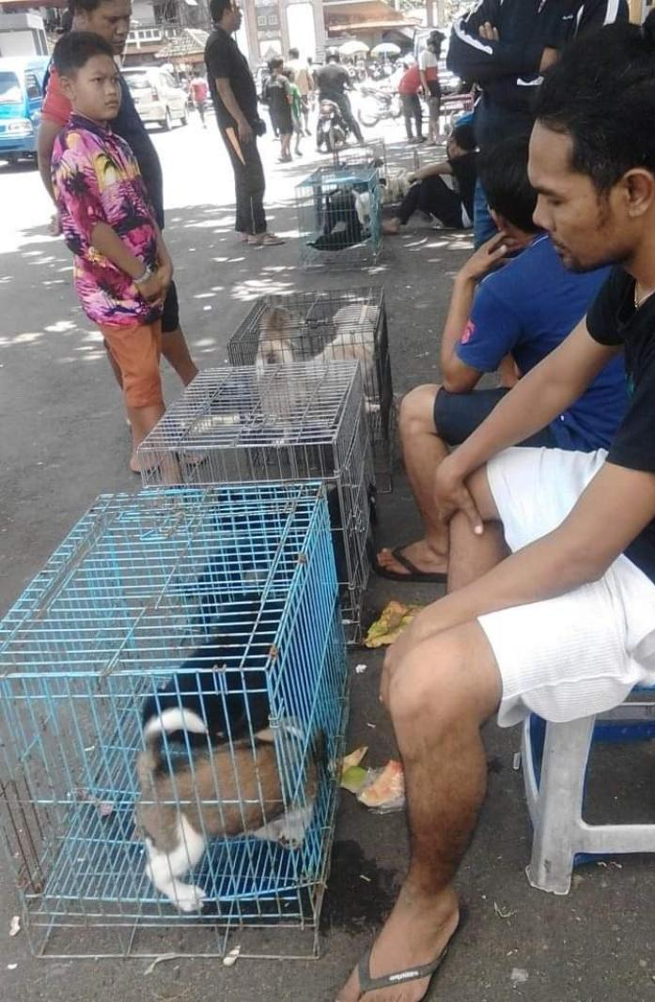

A bit background…

Slide 4
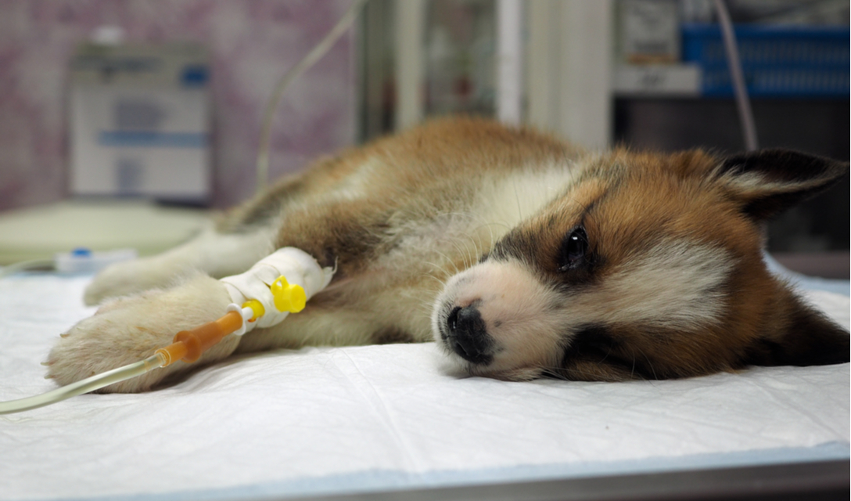

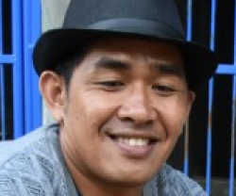

Pak Surya
Pemilik Kennel

Slide 5
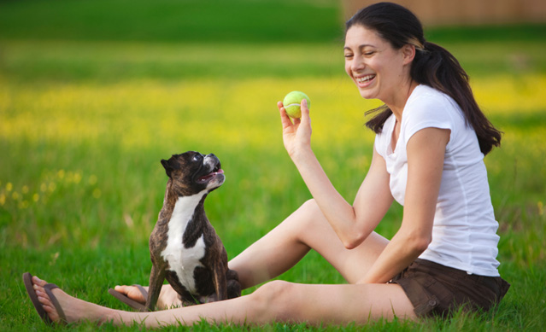
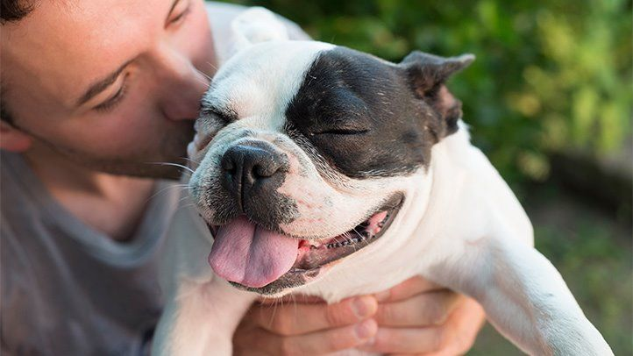
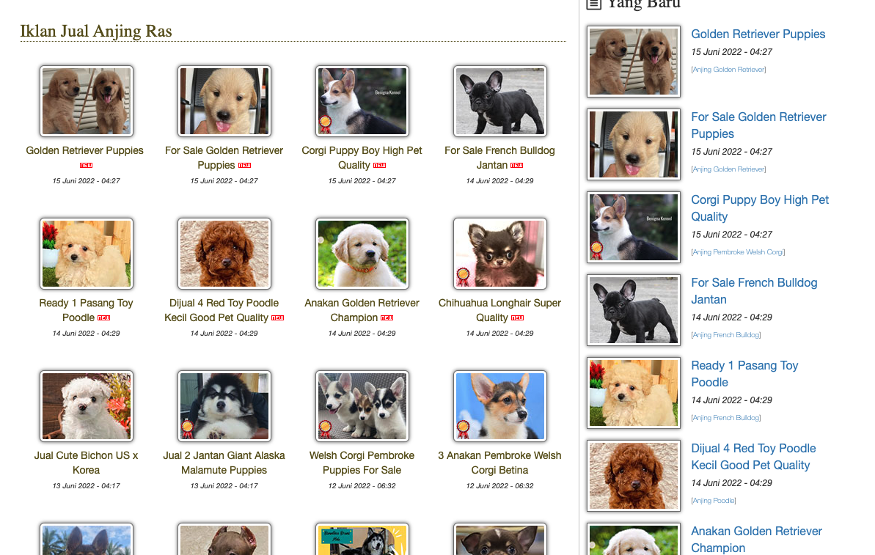
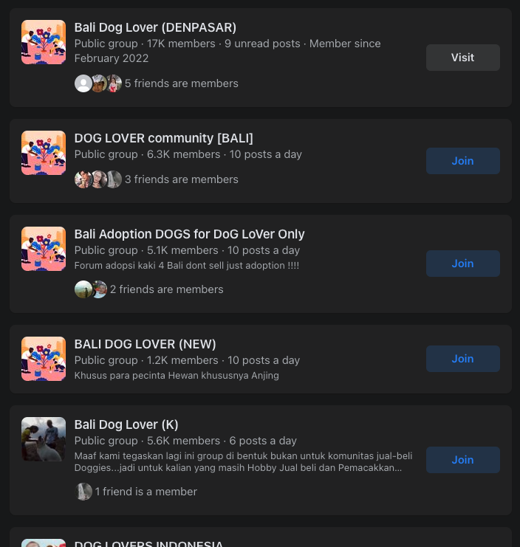
Potential Market

Slide 6
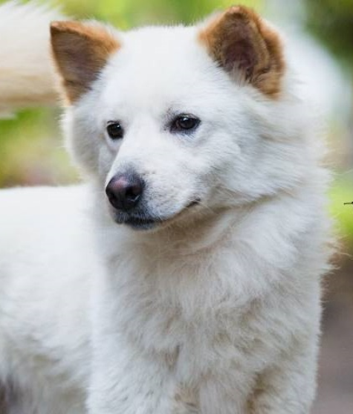
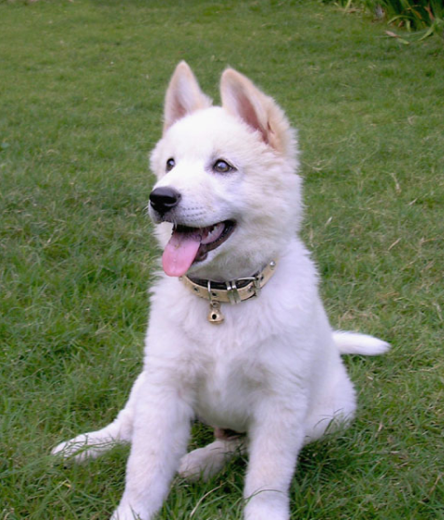
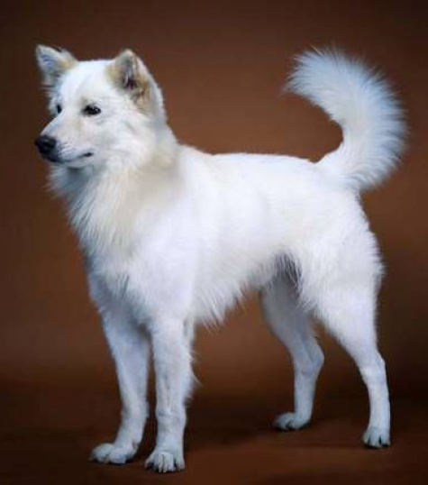
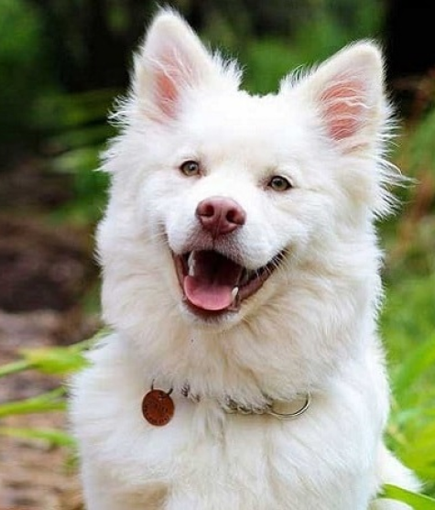
We choose Kintamani Breed 🐶

Slide 7



Why us?
Best Breed
Stambun Certificate
Complete Vaccine

Slide 8




Main Feature
Admin
User Auth
Information
Book Online

Slide 9











Tech Stack
Frontend
Other Lib
Backend
Testing Lib
CI/CD

Slide 10
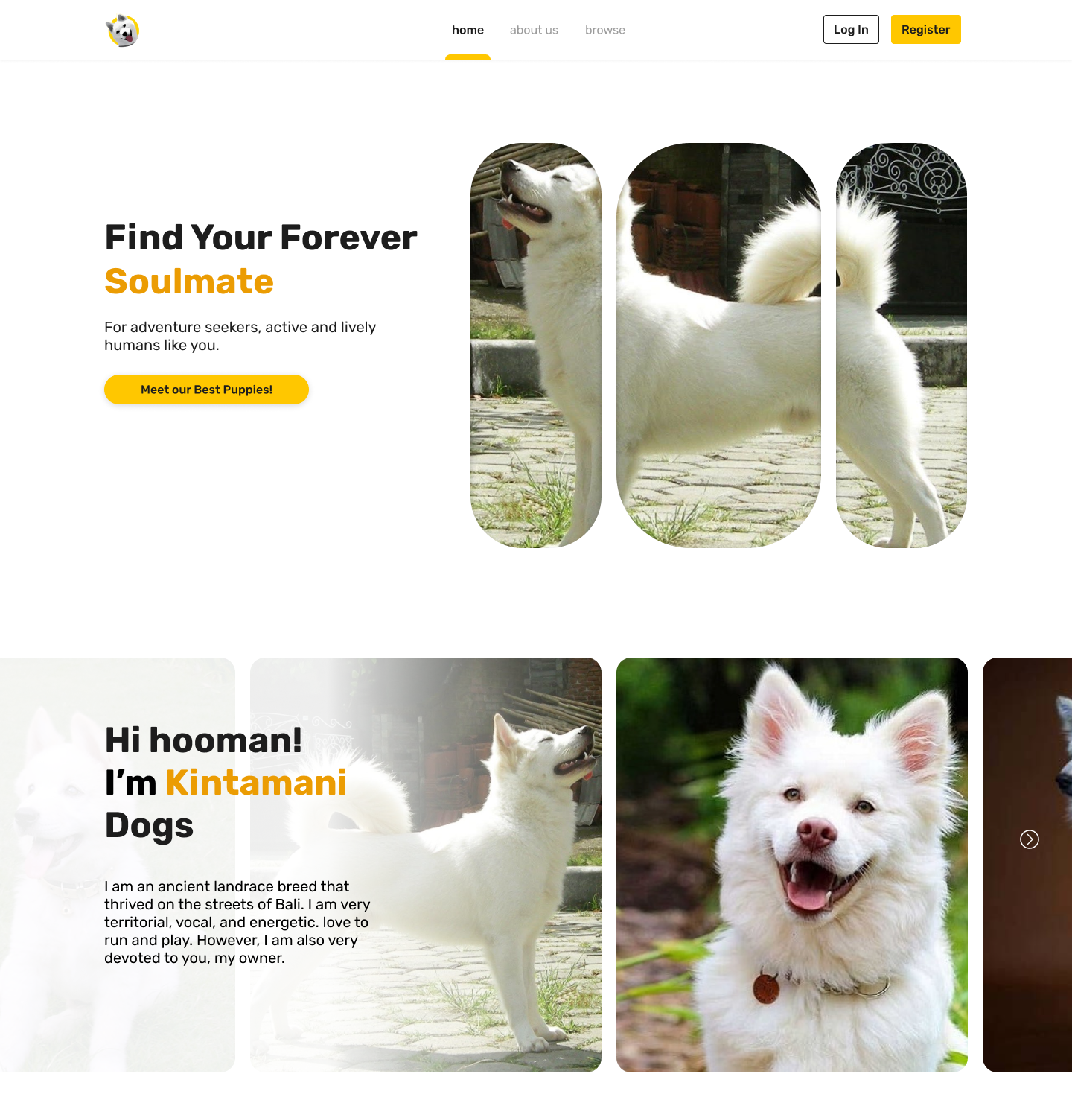
User Interface
Go to figma

Slide 11
Let’s have a demo
asuki.netlify.app

Slide 12
Thank You!

